Slide 1
‹#›
Implementation of Yoga Pose Estimation and Feedback Mechanism using Pose Detection for Self Learning
Team Members Panel Number:16
Project Advisor: Dr. K Raghesh Krishnan / Asst. Professor(SG) / CSE
S.No | Reg.No | Name of the Student | Section
1 | CB.EN.U4CSE18112 | DHANUSH VARMA CH | CSE B
2 | CB.EN.U4CSE18162 | VENKAT R | CSE B
3 | CB.EN.U4CSE18174 | HARSHA VARDHAN D | CSE B
4 | CB.EN.U4CSE18511 | GUHAN K | CSE B

Slide 2
Problem Statement
‹#›
To design a Machine Learning based application that monitors the yoga pose performed by the practitioner and gives real time feedback for improvement of the yoga posture.

Slide 3
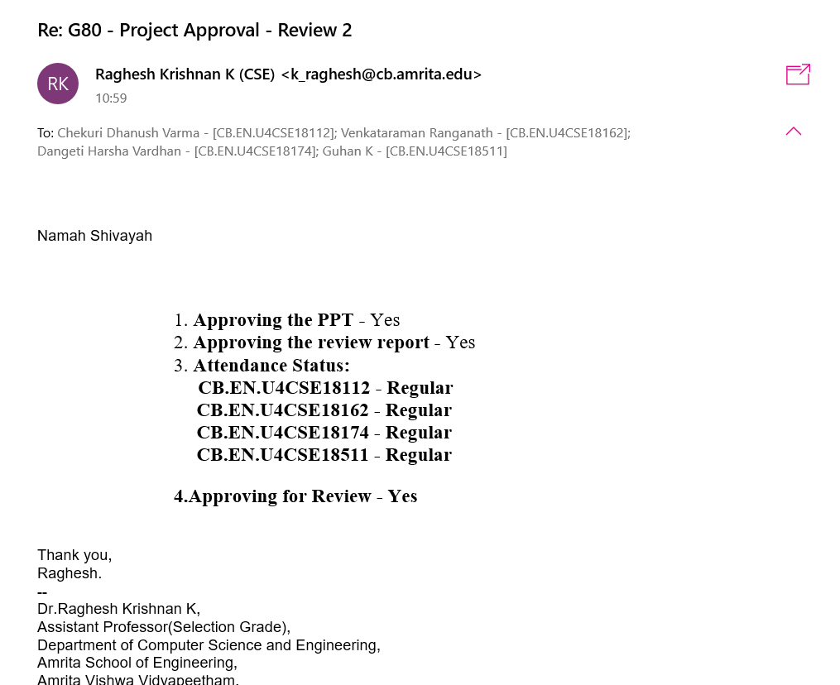
Guide Approval Mail
‹#›

Slide 4
Review 1 Comments and Action Taken
‹#›
COMMENTS | ACTION TAKEN
More important literature could have been added Focus more on preprocessing | Added 3 scopus indexed journal papers for reference Looked into other preprocessing techniques applicable for our dataset (Brightness Adjustment, Contrast Adjustment and Image Sharpening) which will be explained later in the presentation.

Slide 5
Roles and Responsibilities
‹#›
S.No | Reg.No | Name of the Student | Modules
1 | CB.EN.U4CSE18112 | DHANUSH VARMA CH | Application Development Deployment in Cloud Service
2 | CB.EN.U4CSE18162 | VENKAT R | Data Pre Processing Feature Extraction ML Model
3 | CB.EN.U4CSE18174 | HARSHA VARDHAN D | Architecture Diagram Deployment in Cloud Service
4 | CB.EN.U4CSE18511 | GUHAN K | Data Cleaning and Consolidation Data Preprocessing ML Model

Slide 6
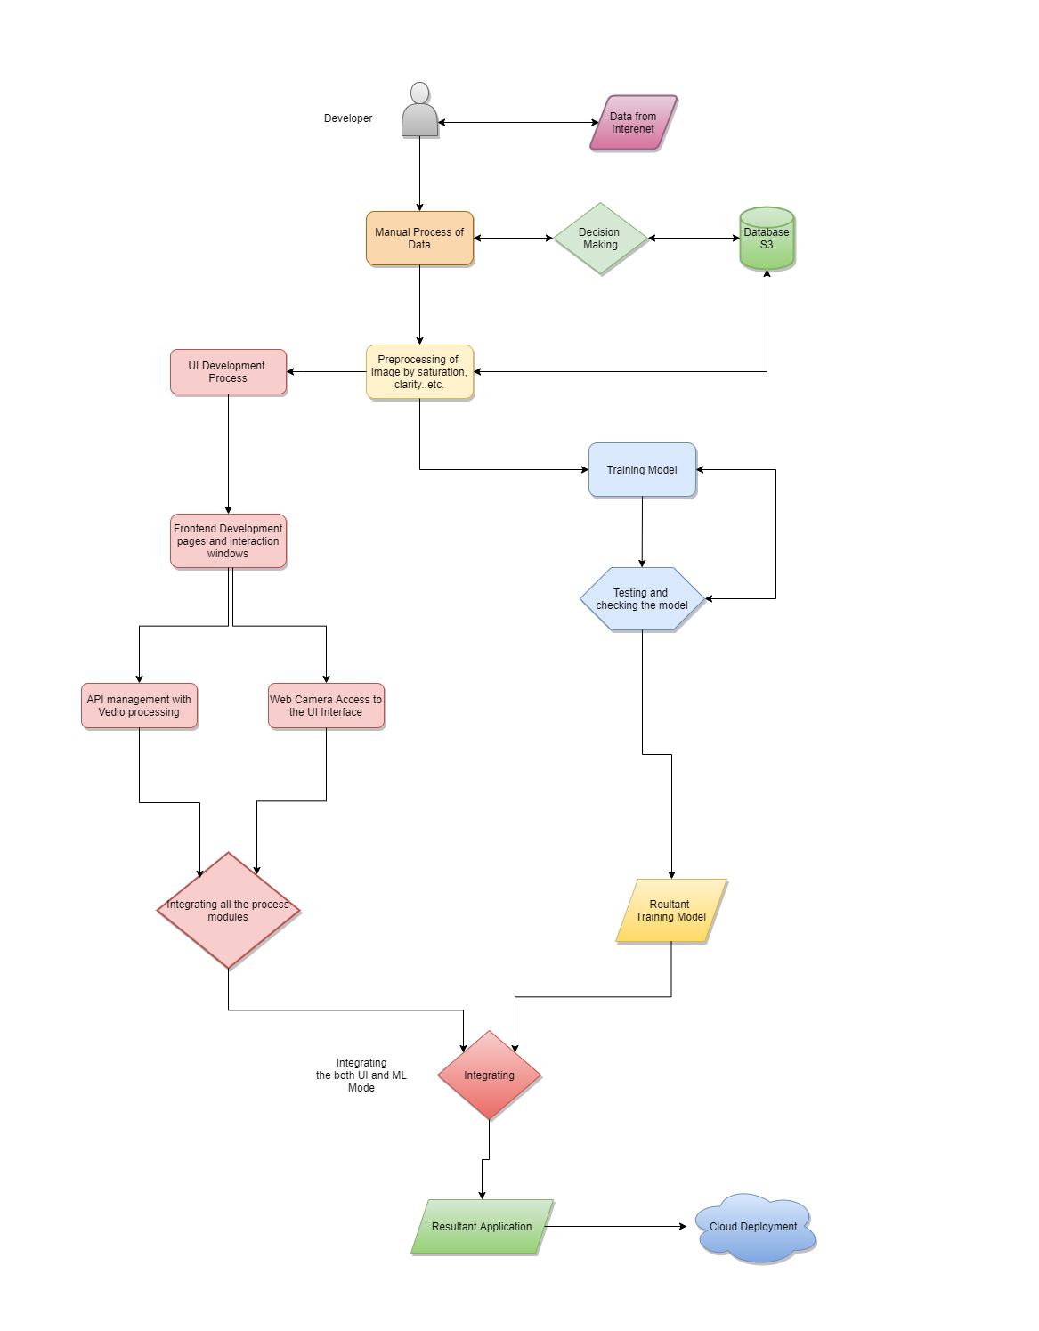
Module Diagram
‹#›

Slide 7
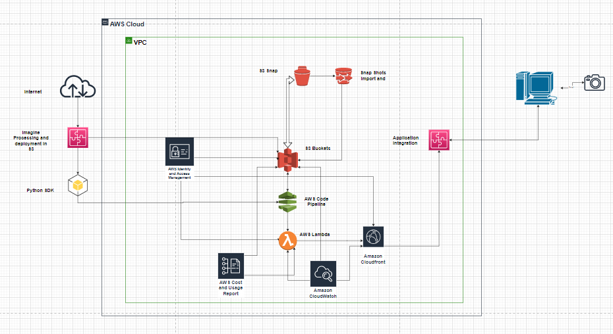
Architecture Diagram
‹#›

Slide 8
Dataset Cleaning and Consolidation
‹#›
Various websites were referred and two different datasets were gathered suitable for training.
Dataset Information:
Yoga 82 dataset prepared by Osaka University, Japan and IIT Gandhinagar, India
The dataset contains a three-level hierarchy including body positions, variations in body positions, and the actual pose name. This dataset contains over 3500 images.
New Yoga Poses Dataset prepared by Niharika, Kaggle
The dataset has all the 5 most famous asanas namely downward dog, plank pose, tree pose, goddess pose and warrior-2 pose. This dataset contains over 1500 images.

Slide 9
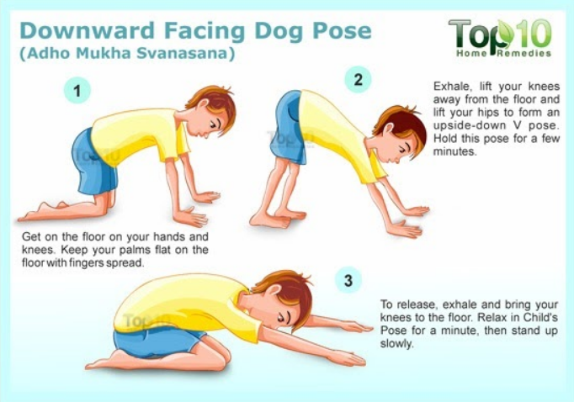
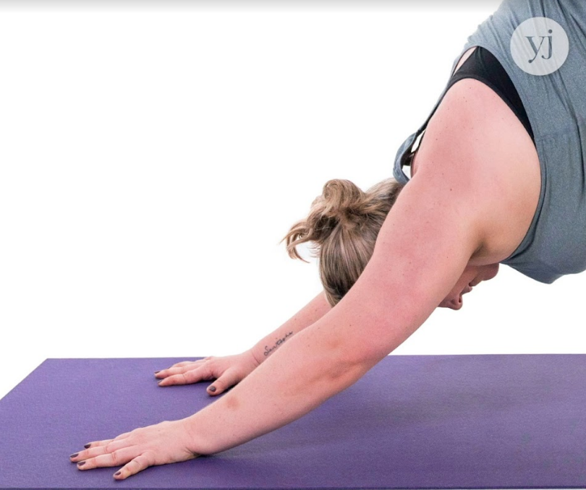
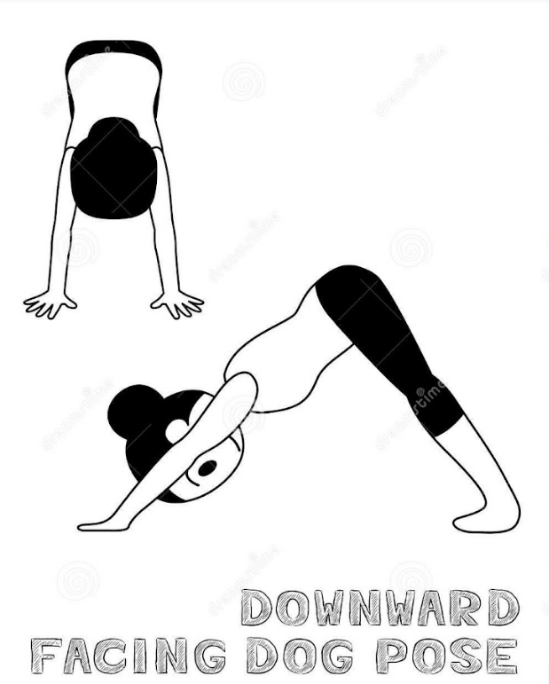
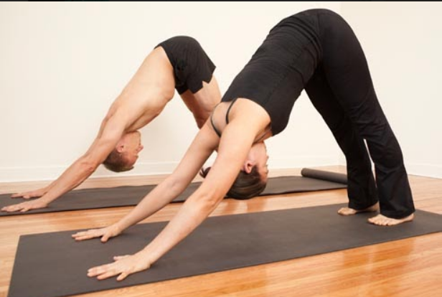
Dataset Cleaning and Consolidation
‹#›
Both datasets are scanned and the images where there is too much text information, person is too small, person is not visible/ part of person is visible, corrupt images, multiple persons in an image, animated images are removed.
Finally, both the datasets are combined into one large training dataset with sub-directories for each asana.
This dataset consists of 5000 images.

Slide 10
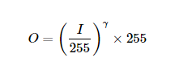
Pre Processing the Image Dataset
‹#›
Image resizing is done because the images come in different resolutions, and high definition images will be more computationally intensive to process. We need to reduce the storage space by discarding unnecessary pixel information.
Brightness Adjustments using Gamma Correction
Gamma correction is a non-linear adjustment to individual pixel values. In image normalization, linear operations are carried out on individual pixels, gamma correction carries out a non-linear operation on the source image pixels, and can cause saturation of the image being altered.
O - Output pixel intensity, I - Input pixel intensity, 𝞬 - gamma correction

Slide 11
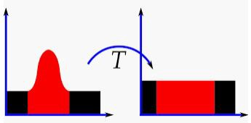
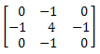
Pre Processing the Image Dataset
‹#›
Contrast Adjustments using Histogram equalization
Adjusts image contrast by its histogram.
To enhance contrast, spreads out intensity range of image.
This allows the image’s areas with lower contrast to gain a higher contrast.
Image Sharpening using Laplacian Filtering
Edge detector used to compute the second derivatives of an image, measuring the rate at which the first derivatives change.
This determines if a change in adjacent pixel values is from an edge or continuous progression.
Laplacian filter kernels usually contain negative values in a cross pattern, centered within the array. The corners are either zero or positive values. The center value can be either negative or positive.

Slide 12
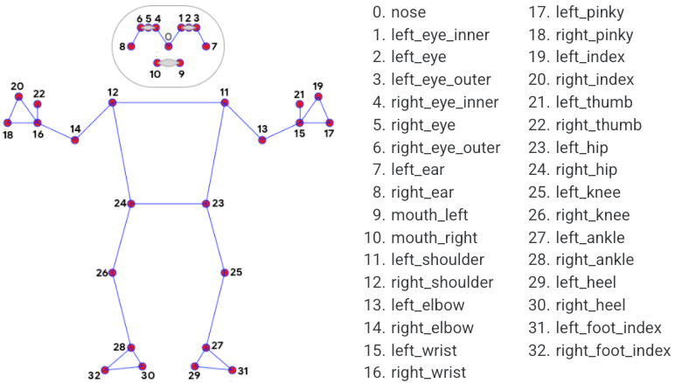
Extracting the body features using MediaPipe Pose
‹#›
MediaPipe Pose is a ML solution for high-fidelity body pose tracking, inferring 33 3D landmarks and background segmentation masks on the whole body from RGB video frames utilizing BlazePose(a pose detection model developed by Google that can compute (x,y,z) coordinates of 33 skeleton key points).
Pose detection works best when the subject’s entire body is visible in the frame, but it also detects a partial body pose. In that case the landmarks that are not recognized are assigned coordinates outside of the image.

Slide 13
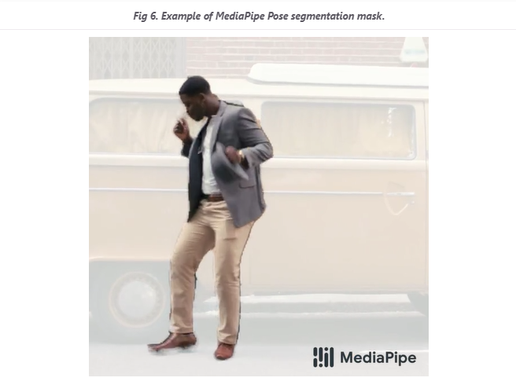
Extracting the body features using MediaPipe Pose
‹#›
SEGMENTATION_MASK
The mask has the same width and height as the input image, and contains values in [0.0, 1.0] where 1.0 and 0.0 indicate “human” and “background” pixel respectively.

Slide 14
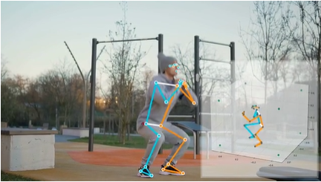
Extracting the body features using MediaPipe Pose
‹#›
OUTPUT: POSE_LANDMARKS
A list of pose landmarks. Each landmark consists of the following:
x and y: Landmark coordinates normalized to [0.0, 1.0] by the image width and height respectively.
z: Represents the landmark depth with the depth at the midpoint of hips being the origin, and the smaller the value the closer the landmark is to the camera.
visibility: A value in [0.0, 1.0] indicating the likelihood of the landmark being visible in the image.

Slide 15
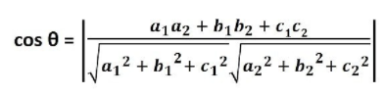
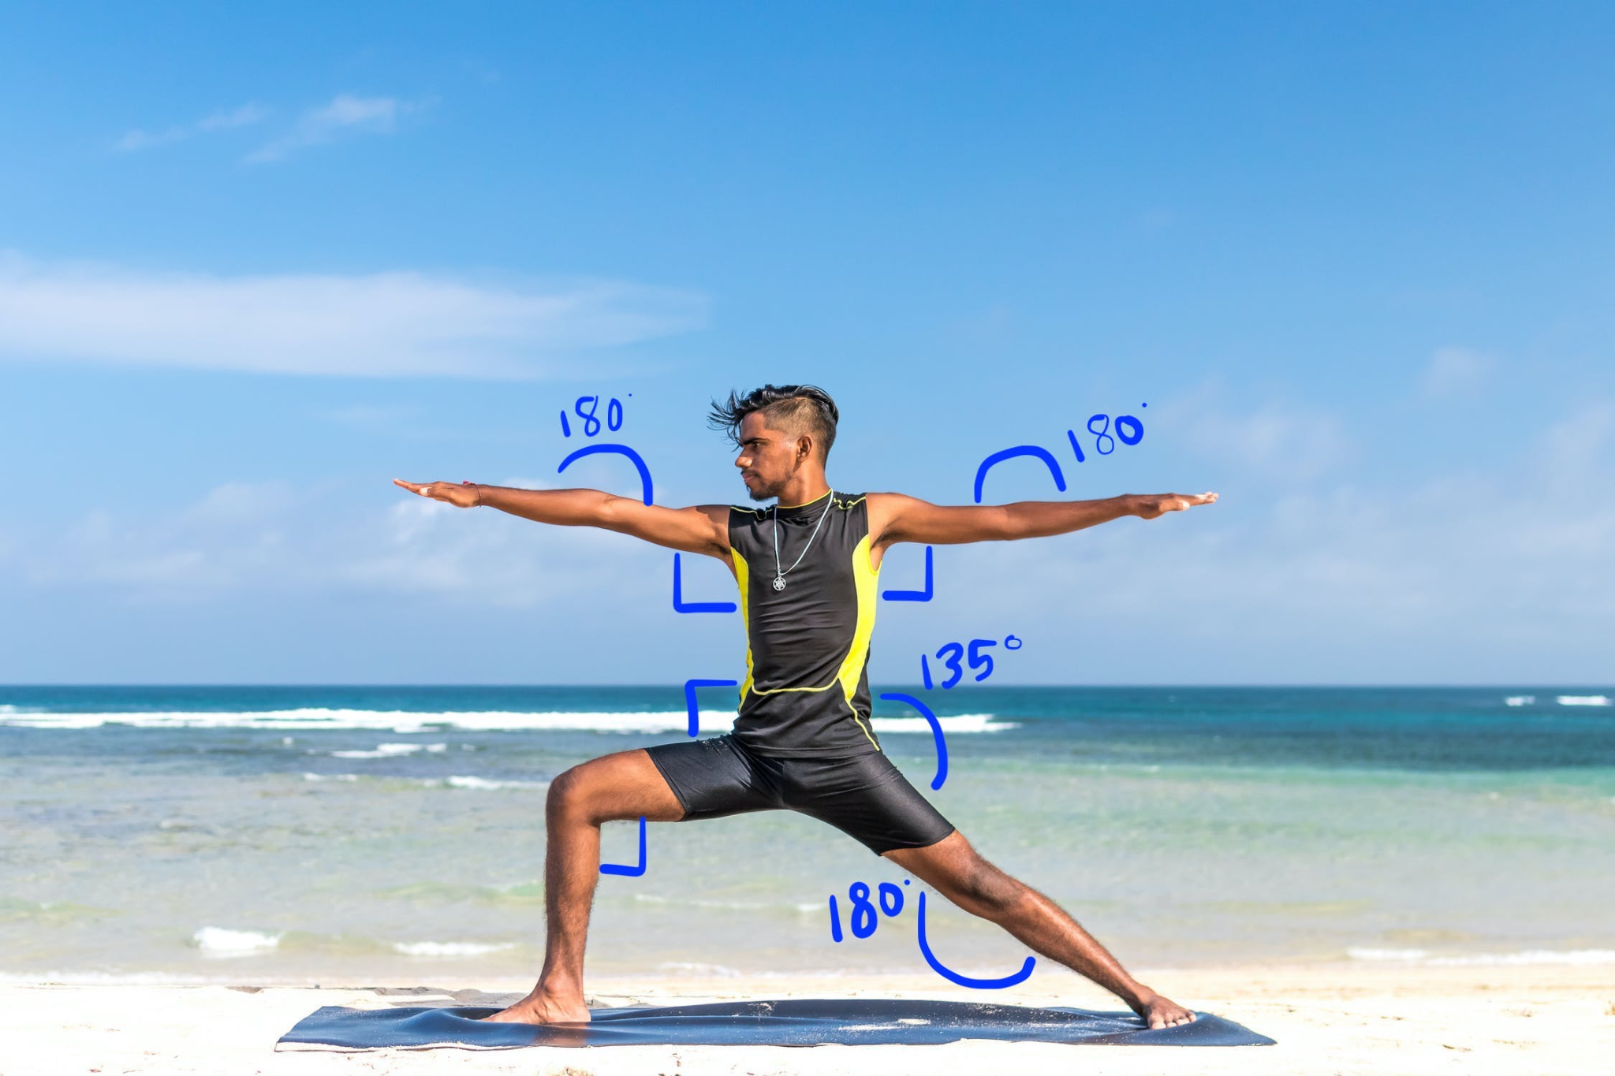
ML Classifier and Feedback
‹#›
Computing angles at joints:
Key angles at ( knee , elbow , shoulder , ankle ) are calculated from the points extracted and labelled with respective Asana name
Angle between a pair of lines having direction a1,b1,c1 and a2,b2,c2 are given by

Slide 16
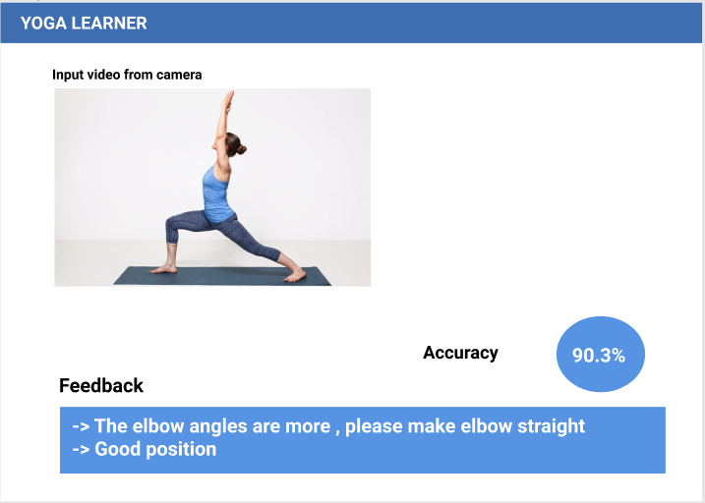
ML Classifier and Feedback
‹#›
Finding the Best fit ML model:
Train and test machine learning algorithms (Random Forest, SVC, Decision Tree,and KNN etc ) using the data generated to find which model best fits .
ML Classifier and feedback :
The yoga pose performed by user is classified into any one of the pretrained asana using machine learning algorithm
Accuracy score and Feedback based on difference in angles of specific pose is displayed to the practitioner for self correction.

Slide 17
Create a UI for the Web Application
‹#›
Welcome Page:
About the app
Purpose of the app
Features and screenshots
Developers Information
Contact us
Application Page:
User clicks on the start button
Users must allow webcam access to start performing. If not, display a warning instructing the person to turn on the webcam.
Display a short video, on steps to be performed for the asana.
User is then allowed to perform the asana for 15 seconds.
At the end of 15 seconds, a screenshot of the user is submitted for processing.
Finally, the user will get the feedback on how they have performed the pose. If the results are good, the image will be sent as training data for the same asana.

Slide 18
Deploy the application in the Cloud Service
‹#›
The platform used to deploy the application in the cloud service for functioning like AWS
AWS Lambda :
Serverless computing service as part of Amazon Web Services, helps you run your code without managing the underlying infrastructure.
Very cheap because you only pay when you invoke the lambda function (that is, when you make prediction requests). Saves a lot of money compared to the cost of running containers or VMs.
Monitors real-time metrics including error rates, total requests, function-level concurrency usage, latency, and throttled requests through Amazon CloudWatch.
GCP
Google AI Platform:
Google AI Platform provides comprehensive machine learning services. Data Scientists and Machine Learning Engineers can use this platform to work on machine learning projects from ideation to deployment more effectively.
Google App Engine:
Google App Engine is a Platform as a service (PaaS) provided by Google that supports the development and hosting of different scalable web applications.
Google App Engine Provides an auto-scaling feature that automatically allocates resources so your web application can handle more requests.
Google Cloud Functions:
Google Cloud Function is a serverless computing platform that offers Functions as a service (FaaS) to run your code with zero server management.

Slide 19
Deploy the application in the Cloud Service
‹#›
AZURE
Microsoft Azure Functions
Azure Functions is a serverless cloud service provided by Microsoft Azure as a Functions-as-a-service (FaaS).
If you have a big machine learning model, then Azure functions are the right choice for you. It supports the deployment of large ML packages such as deep learning frameworks (Tensorflow and Pytorch).

Slide 20
Conclusion
‹#›
This work proposes a system for Yoga Pose Training and Feedback System to help the self-learning of Yoga for five different poses. The system assesses a Yoga pose of a learner by detecting the human body first using the webcam, extracting the coordinated points of various joints in the body, calculating the difference of body angles between the trained pose images and that of the user accurately and finally provide real-time feedback on improvisation of the incorrect parts between learner and the trained images.

Slide 21
References
‹#›
Yash Agrawal, Yash Shah, Abhishek Sharma, "Implementation of Machine Learning Technique for Identification of Yoga Poses", Communication Systems and Network Technologies (CSNT) 2020 IEEE 9th International Conference on, pp. 40-43, 2020. https://ieeexplore.ieee.org/document/9115758
Maybel Chan Thar, Khine Zar Ne Winn, Nobuo Funabiki, "A Proposal of Yoga Pose Assessment Method Using Pose Detection for Self-Learning", Advanced Information Technologies (ICAIT) 2019 International Conference on, pp. 137-142, 2019. http://ieeexplore.ieee.org/document/8920892/
Muhammad Usama Islam, Hasan Mahmud, Faisal Bin Ashraf, Iqbal Hossain, Md. Kamrul Hasan, "Yoga posture recognition by detecting human joint points in real time using microsoft kinect", Humanitarian Technology Conference (R10-HTC) 2017 IEEE Region 10, pp. 668-673, 2017.
https://ieeexplore.ieee.org/document/8289047
Deepak Kumar, Anurag Sinha, ”Yoga Pose Detection and Classification Using Deep Learning” 2020 International Journal of Scientific Research in Computer Science Engineering and Information Technology https://ijsrcseit.com/CSEIT206623
T.-L. Le et al., "Human posture recognition using human skeleton provided by Kinect", Proc. International Conference on Computing Management and Telecommunications, 2013. https://ieeexplore.ieee.org/document/6482417
Sankara Narayanan, Devendra Kumar Misra , Kartik Arora and Harsh Rai, “Yoga Pose Detection Using Deep Learning Techniques” 2021 Social Science Research Network (SSRN) https://papers.ssrn.com/sol3/papers.cfm?abstract_id=384265
Guo, Y., Ma, L., Li, Z., Wang, X., & Wang, F. (2021). Monocular 3D multi-person pose estimation via predicting factorized correction factors. Computer Vision and Image Understanding, 213 doi:10.1016/j.cviu.2021.103278
Wang, Y. and Ye, J. (2021). “Tmf: Temporal motion and fusion for action recognition.”Computer Vision and Image Understanding, 103304.
Wheeler, B. J. and Karimi, H. A. (2021). “A semantically driven self-supervised algorithm for detecting anomalies in image sets.”Computer Vision and Image Understanding, 103279.

Slide 22
THANK YOU

